Slide 1


GDPR Compliant…Now What Else Are You Missing?

Slide 2
GDPR Compliance•
Now what else are you missing?
The new Swiss Data Protection Act
(in force since September 1, 2023)
David Rosenthal, Partner, VISCHER AG
October 4, 2023

Slide 3
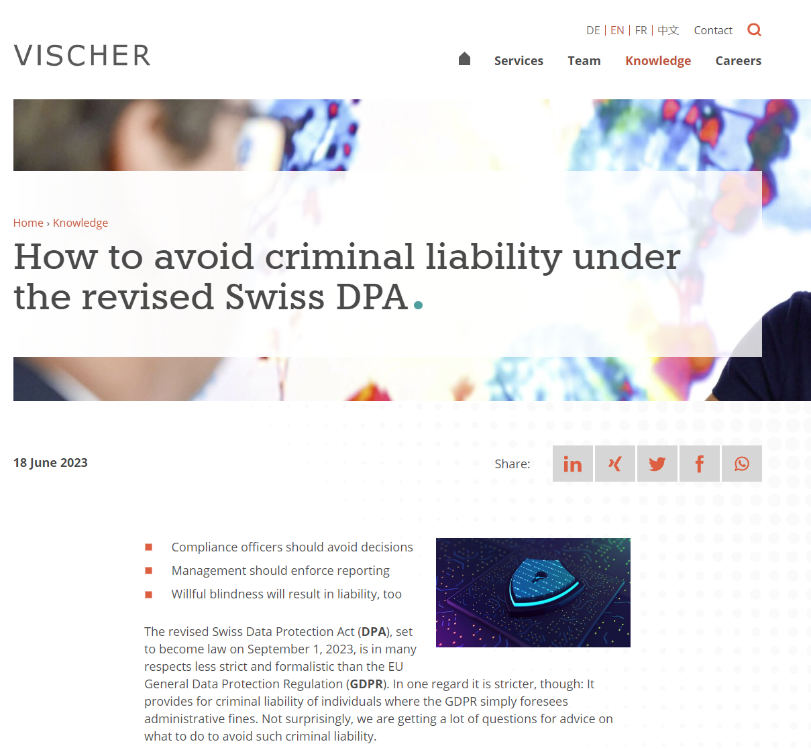
The "Swiss Finish"
https://bit.ly/3LHUVtK
Broader extraterritorial reach than the GDPR
GDPR privacy notices need additional language
Fewer/different grounds to push back on access requests
Data breach notifications to data subjects whenever this is necessary for their protection, even if there is no high risk
Fewer adequacy decisions, EU SCC require Swiss amendments
Every employee is under a professional secrecy
Criminal fines against individuals of up to CHF 250'000 (non insurable!) for non-compliance with selected provisions – including for willful blindness by the board and management
For the DPO and for the management – having the right policies is key
Privacy notices
Processor agreements
Cross-border transfers
Minimum data security
Access requests
Professional secrecy

Slide 4
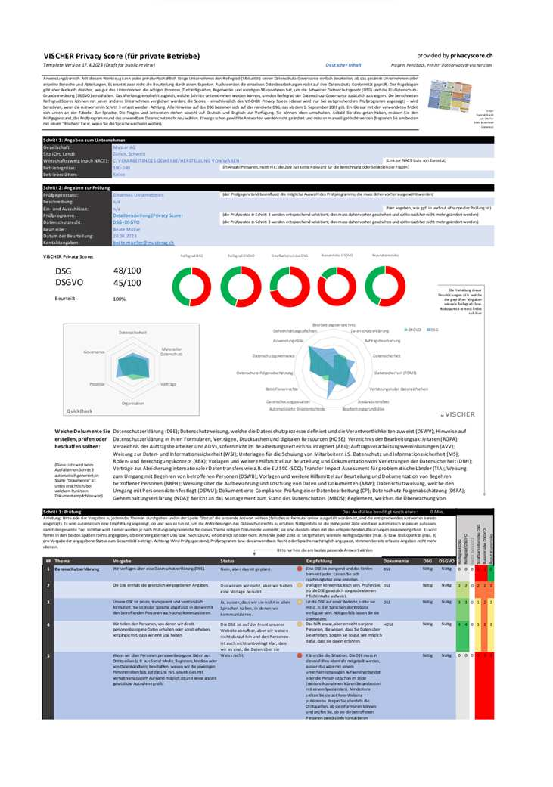
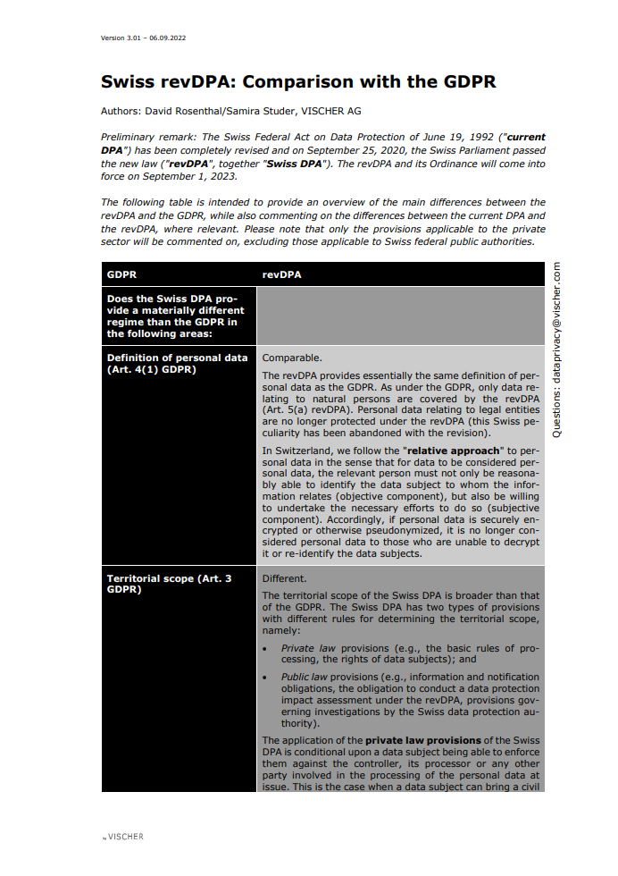
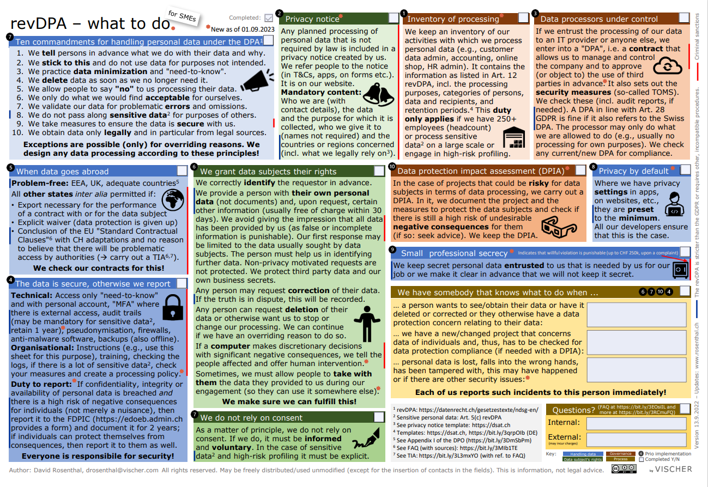
More guidance for you
https://www.rosenthal.ch/downloads/VISCHER-revDPA-Survival-Guide.pdf
https://www.vischer.com/en/knowledge/blog/the-new-data-protection-act-dpa-on-just-one-page-39755/
https://privacyscore.ch/en
https://www.rosenthal.ch/downloads/VISCHER-revDPA-GDPR-Comparison.pdf

Slide 5
Questions?
drosenthal@vischer.com

Slide 6

CLE CODE #1 = CONSUMER
GDPR Compliant?
The United States Complicates Everything
Melinda McLellan, Partner, New York City
Nichole Sterling, Partner, New York City
October 4, 2023

Slide 7
State Comprehensive Privacy Laws
Other Parts of the U.S. Alphabet Soup
Children’s Online Privacy Protection Act (COPPA)
Health Insurance Portability & Accountability Act (HIPAA)
Fair Credit Reporting Act (FCRA)
Gramm-Leach-Bliley Act (GLBA)
Telephone Consumer Protection Act (TCPA)
Video Privacy Protection Act (VPPA)
Illinois Biometric Information Privacy Act (BIPA)
Washington’s My Health My Data Act
California Consumer Privacy Act
Effective January 1, 2020
Amended California Consumer Privacy Act
Virginia Consumer Data Protection Act
Effective January 1, 2023
Colorado Privacy Act
Connecticut Personal Data Privacy and Online Monitoring Act
Effective July 1, 2023
Utah Consumer Privacy Act
Effective December 31, 2023
Oregon Consumer Privacy Act
Texas Data Privacy and Security Act
Effective July 1, 2024
Montana Consumer Data Privacy Act
Effective October 1, 2024
Delaware Personal Data Privacy Act
Iowa Consumer Data Protection Act
Effective January 1, 2025
Tennessee Information Protection Act
Effective July 1, 2025
Indiana Consumer Data Protection Act
Effective January 1, 2026

Slide 8

Key U.S. State Privacy Law Compliance Differences from the GDPR
Scope and applicability
Defining personal data
Consents and opt outs
Sales, sharing, and targeted advertising
Notice and transparency
Data processing agreements
Exceptions to compliance
Automated decision making

Slide 9

CLE Code #2 = Accommodation
Website Accessibility Under Title III of The Americans With Disabilities Act (ADA)
Joyce Ackerbaum Cox, Partner, Orlando
October 4, 2023

Slide 10
Title III of the ADA and Places of Public Accommodation
The ADA prohibits discrimination against individuals with disabilities in all areas of public life, including jobs, schools, transportation, and all public and private places that are open to the general public.
Title III of the ADA requires businesses that qualify as places of “public accommodation” to provide equal access to their goods and services to individuals with disabilities.
  Specifically, 28 CFR § 36.201(a) provides: No individual shall be discriminated against on the basis of a disability in the full and equal enjoyment of the goods, services, facilities, privileges, advantages, or accommodations of any place of public accommodation by any private entity who owns, leases (or leases to), or operates a place of public accommodation.
ADA obligations include providing auxiliary aids and services necessary to effectively communicate with individuals with hearing, vision or cognitive disabilities.

Slide 11
What Is a Place of Public Accommodation?
Title III provides that private entities are considered places of public accommodation if their operations affect commerce and fall within at least one of the following 12 categories:
An inn, hotel or other place of lodging
A restaurant, bar or other establishment serving food or drink
A motion picture house, theater, concert hall, stadium or other place of exhibition/entertainment
An auditorium, convention center, lecture hall, or other place of public gathering
A bakery, grocery store, clothing store, hardware store, shopping center or other sales or rental establishment
A laundromat, dry cleaner, bank, barbershop, beauty shop, travel service, shoe repair service, funeral parlor, gas station, office of an accountant or lawyer, pharmacy, insurance office, professional office of a healthcare provider, hospital, or other service establishment
A terminal, depot or other station used for public transportation
A museum, library, gallery or other place of public display or collection
A park, zoo, amusement park or other place of recreation
A nursery, elementary, secondary, undergraduate or postgraduate private school or other place of education
A day care center, senior citizen center, homeless shelter, food bank, adoption agency or other social service center
A gymnasium, health spa, bowling alley, golf course or other place of exercise or recreation

Slide 12
Does the ADA Apply to Websites?
The Department of Justice, which enforces Title III of the ADA, believes it does.
“Inaccessible web content means that people with disabilities are denied equal access to information. An inaccessible website can exclude people just as much as steps at an entrance to a physical location. Ensuring web accessibility for people with disabilities is a priority for the Department of Justice. In recent years, a multitude of services have moved online and people rely on websites like never before for all aspects of daily living.”
The DOJ has specifically stated, “Businesses open to the public must take steps to provide appropriate communication aids and services (often called “auxiliary aids and services”) where necessary to make sure they effectively communicate with individuals with disabilities. …A website with inaccessible features can limit the ability of people with disabilities to access a public accommodation’s goods, services, and privileges available through that website.
Courts are wrestling with the issue of whether Title III covers websites.
Split of authority as to whether websites are a “place of public accommodation” or otherwise subject to the ADA, and if so, who has standing to sue.
And, if websites are required to be accessible, what standards apply to them?

Slide 13
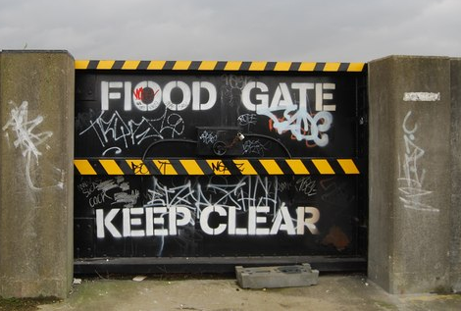
The Floodgates Are Open …
Since 2017, thousands of lawsuits have been filed regarding website accessibility.
In 2021, more than 6,300 Title III ADA lawsuits were filed, and in 2022, 4900 were filed.
Halfway through 2023, there have been about 4000 lawsuits filed.
The most popular states are California, Florida, New York, Texas, and Pennsylvania.
Current case before SCOTUS, Acheson v. Laufer, where Court is determining whether a “tester” has standing to sue under Title III of the ADA, even when she has no intention of visiting the location; Oral argument set for 10/4/23.

Slide 14
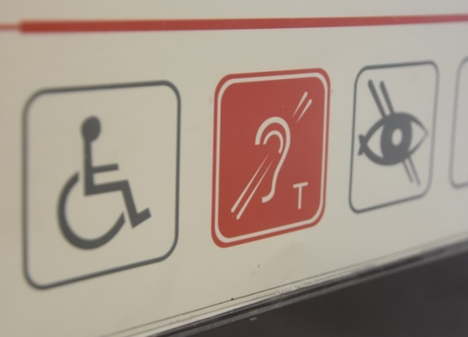
Disabilities Affecting Internet Use
According to the Department of Justice (DOJ), millions of Americans have disabilities that affect their use of internet websites and mobile applications including vision, hearing, mobility and intellectual disabilities.
Website barriers include:
Poor color contrast. People with limited vision or color blindness cannot read text if there is not enough contrast between the text and background (for example, light gray text on a light-colored background).
Use of color alone to give information. People who are color-blind may not have access to information when that information is conveyed using only color cues because they cannot distinguish certain colors from others.
Lack of text alternatives (“alt text”) on images. People who are blind will not be able to understand the content and purpose of images, such as pictures, illustrations, and charts, when no text alternative is provided. Text alternatives convey the purpose of an image, including pictures, illustrations, charts, etc.
No captions on videos. People with hearing disabilities may not be able to understand information communicated in a video if the video does not have captions.
Mouse-only navigation (lack of keyboard navigation). People with disabilities who cannot use a mouse or trackpad will not be able to access web content if they cannot navigate a website using a keyboard.

Slide 15

Website Accessibility
No specific standards or regulations under the Title III of ADA.
World Wide Web Consortium (W3C) -- A private-industry international community where member organizations, a full-time staff and the public work together to develop web standards. See https://www.w3.org/
  W3C developed the Web Content Accessibility Guidelines (WCAG). Courts/DOJ often look to the WCAG standards to determine ADA accessibility of a website.
    WCAG 2.0 was published on 11 December 2008.
    WCAG 2.1 was published on 5 June 2018, and an update was published on 21 September 2023.
    WCAG 2.2 is scheduled to be published in 2023.
    WCAG 2.1 Standards are available at: https://www.w3.org/TR/WCAG21/

Slide 16

Where to Look for Guidance – WCAG
The WCAG standards have 12-13 guidelines. The guidelines are organized under 4 principles: perceivable, operable, understandable, and robust.
For each guideline, there are testable success criteria. The success criteria are at three levels: A, AA, and AAA.
The success criteria are what determine “conformance” to WCAG. That is, in order to meet WCAG, the content needs to meet the success criteria.

Slide 17
General Overview of WCAG 2.1 Standards*
Perceivable
Provide text alternatives for non-text content.
Provide captions and other alternatives for multimedia.
Create content that can be presented in different ways, including by assistive technologies, without losing meaning.
Make it easier for users to see and hear content.
Operable
Make all functionality available from a keyboard.
Give users enough time to read and use content.
Do not use content that causes seizures or physical reactions.
Help users navigate and find content.
Make it easier to use inputs other than keyboard.
Understandable
Make text readable and understandable.
Make content appear and operate in predictable ways.
Help users avoid and correct mistakes.
Robust
Maximize compatibility with current and future user tools.
*https://www.w3.org/WAI/standards-guidelines/wcag/glance/

Slide 18

Key Takeaways
Modify your website to improve or increase accessibility; consider using WCAG.
Include an accessibility statement on the home page of your website.
Hire or utilize someone with proper technical knowledge to make website improvements.
Ensure that new content added to website is accessible.
Conduct periodic audits to ensure websites remain accessible.
Require third parties posting content or linked to your website to be accessible.

Slide 19



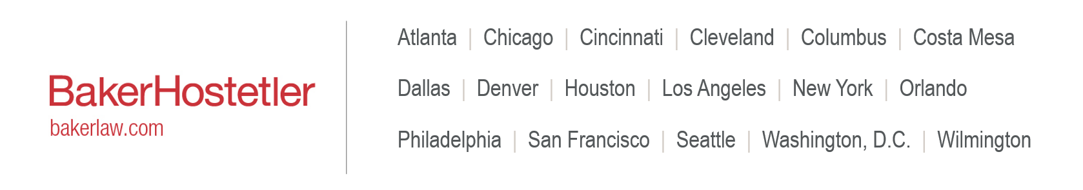
Questions?
Joyce Ackerbaum Cox
jacox@bakerlaw.com
Melinda McLellan
mmclellan@bakerlaw.com
Nichole Sterling
nsterling@bakerlaw.com
19

